Slide 1

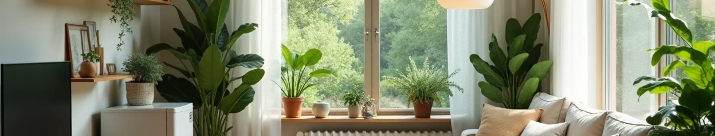

GREEN HOME LOAN – A Smart Step Toward a Greener Future

Slide 2

CONTENTS
1. Why Green?
2. Product Overview – Green Home Loan
3. Target Customers
4. How to Sell It
5. Marketing Strategy
6. Revenue & Growth Potential

Slide 3

01
Why Green?

Slide 4



Why Green?
Eco-awareness and climate trends
Benefits of green homes (cost-saving, sustainability)
Customer interest in eco-living

Slide 5

02
Product Overview – Green Home Loan

Slide 6
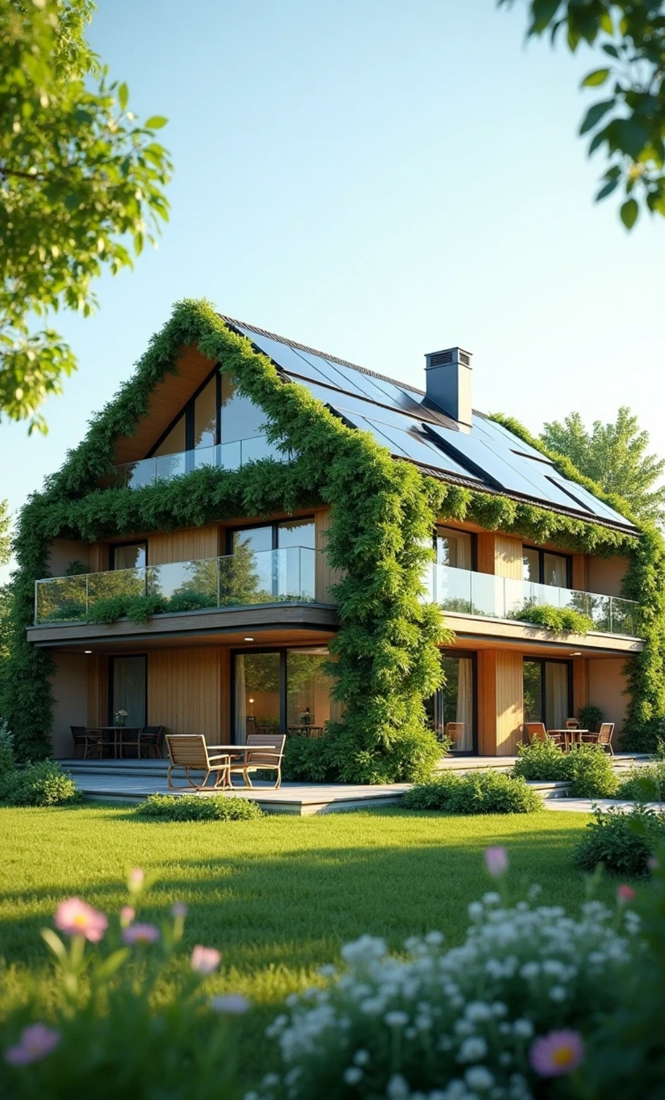

Product Overview – Green Home Loan
1
Lower interest rates for eco-friendly houses
2
Covers solar panels, insulation, smart home tech
3
Easy application process and fast approval

Slide 7

03
Target Customers

Slide 8


Target Customers
Young families
Eco-conscious individuals
Real estate buyers building or renovating green homes

Slide 9

04
How to Sell It

Slide 10

How to Sell It
1
Focus on customer benefits: comfort, savings, health
2
Use personal stories and simple comparisons
3
Emphasize long-term cost efficiency

Slide 11

05
Marketing Strategy

Slide 12


Marketing Strategy
Social media campaign idea: /#GreenGoals2025
Posters and digital signage in branches
Webinars or influencer partnerships on green living

Slide 13

06
Revenue & Growth Potential

Slide 14

Revenue & Growth Potential
1
More product uptake = cross-selling opportunities
2
Boost to brand image as a sustainable bank
3
Incentives for high-performing sales team

Slide 15

Thank You

Slide 16

08
Visual Style

Slide 17


Visual Style
1
2
3
4
Use green and white color palette
Include eco-themed icons or illustrations (plants, homes, solar panels)
Use friendly and modern fonts
Make it easy to read and understand – no heavy text

Slide 18
07
Team Call to Action

Slide 19


Team Call to Action
1
2
3
Motivate the team: “Be part of the green change!”
Show a timeline or checklist for launch
Add Q&A slide if needed

Slide 20

10
Optional Activity Ideas

Slide 21


Optional Activity Ideas
Quick quiz or roleplay
Group brainstorming slide for marketing ideas

